Slide 1














Home
About Us
Portfolio
Contact
What methods
were used
to tackle chess?

Slide 2

Efficiently find sliding moves of chess pieces
Bit representation
Mask of related bits
Magic number multiplications
Right-shifting to create an index
Pre-initialized mobiles database
Tackle the issue of space-time-tradeoff
Magic Bitboard
Key steps:

Slide 3









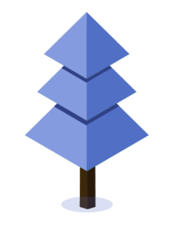


Home
About Us
Portfolio
Contact
Move Picking & Ordering (histories)
The following standard techniques are commonly employed in the process of finding a good first move:
01
Select the PV-Move
The PV-Move is selected from the principal variation of the previous iteration.
02
Use internal Iterative Deepening
Internal Iterative Deepening is utilized when no hash move is available(only at PV-Nodes).
03
Choose the Hash Move
If available, the Hash Move is chosen, which is a stored move from the Transposition Table.

Slide 4



Home
About Us
Portfolio
Contact
Transposition Table
Store key infor. about the previously calculated situations
Basis： Hash Table
Function:
eliminate illegal movements, efficiently
used in both search heuristics and move ordering
When encountering a new location:
Check if the location has been analyzed
√ use directly
× calculate the value & input the new location into the hash table

Slide 5
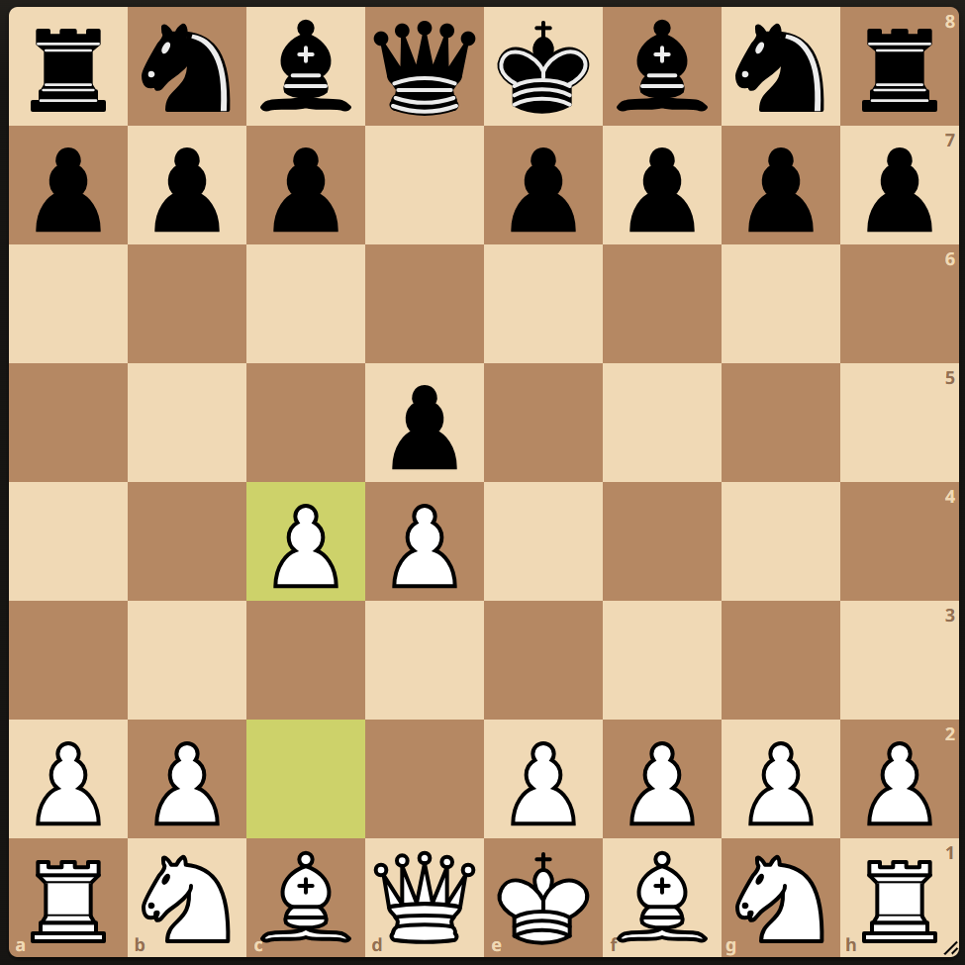
Transposition table
This position can occur after:
1. d4 d5
2. c4 ...
1. c4 d5
2. d4 ...
1. d4 d5
2. c4 c6
3. d3 e6
4. Nf3 Nc6
Notes:
It makes no sense to calculate this position again since we should already know what the best move is from here.
Let us say we searched 8 ply from the start position and found a line:
and evaluated it to +10.
When we get to this position after 1. c4 d5 2. d4 ... we already know that the best answer black has is c6 and the evaluation is +10.
So we just saved 5 plies of searching.

Slide 6
Negamax Alpha-Beta Pruning
Quiescence Search (& SEE)
overcome “Horizon Effect”
LMR, LMP, NMP, etc.
Control the Search Tree
Cut-off bad nodes
Search
Home
About Us
Portfolio
Contact

Slide 7
Evaluation
NNUE (Efficiently Updatable Neural Network):
1. Accumulator & SIMD (AVX512VNNI, AVX512, AVX2 etc)
2. ClippedReLU
3. Training: require backward propagation with gradient
operation and adam
Advantages:
Quick evaluation
Efficient update
Simple network

Slide 8


Evaluation
Drawback of NNUE:
lack of specific material headers in Lc0’s network
Improvement: SimpleEval
combining tuned material values and counts with NNUE’s score
Home
About Us
Portfolio
Contact

Slide 9

Conclusion
Algorithms:
Bitboards
Move Generation
The Minimax algorithm
evaluation functions
a significant milestone
How do AI technologies develop
in the future?
Board games have limitations for training AI, and it's time to focus more on solving real-world problems, such as dealing the issue of manufacture of medicine.

Slide 10
References
[1] Thomas S Anantharaman. Extension heuristics. ICGA Journal, 14(2):47–65, 1991.
[2] Don F Beal. A generalised quiescence search algorithm. Artificial Intelligence,
43(1):85–98, 1990.
[3] M Campbell, A Joseph Hoane, and Feng-hsiung Hsu. Search control methods in
deep blue. In AAAI Spring Symposium on Search Techniques for Problem Solving
under Uncertainty and Incomplete Information, pages 19–23, 1999.
[4] Murray Campbell, A Joseph Hoane Jr, and Feng-hsiung Hsu. Deep blue. Artificial
intelligence, 134(1-2):57–83, 2002.
[5] Omid E David, Nathan S Netanyahu, and Lior Wolf. Deepchess: End-to-end deep
neural network for automatic learning in chess. In Artificial Neural Networks and Machine Learning–ICANN 2016: 25th International Conference on Artificial
Notes:
It makes no sense to calculate this position again since we should already know what the best move is from here.
Let us say we searched 8 ply from the start position and found a line:
and evaluated it to +10.
When we get to this position after 1. c4 d5 2. d4 ... we already know that the best answer black has is c6 and the evaluation is +10.
So we just saved 5 plies of searching.

